Slide 1
Tanmai Kumar Ghosh
Nucleic Acid Memory

Slide 2
Introduce yourself
I am a first year Computer Science PhD student. My research interests are Artificial Intelligence and Computer vision.
I am doing my research under Dr. Tim Andersen.
I am always curious to adapt new skills and it can be anything.

Slide 3
Topic introduction
The goal of this presentation is to make my knowledge transparent to the team what I learned for the last few months. I tried to understand the work done so far in the Nucleic Acid memory. I would appreciate any additions and feedbacks.

Slide 4
Introduction
For the last decade, sequence-based DNA data storage was the primary focus.
The mapping scheme was done by assigning binary data bits to each nucleotides.
For example, 00 -> A, 01 -> T, 10 -> G,11 -> C
Then, DNA synthesis technology has been used to to convert the sequences into physical strands of DNA.
The main drawbacks of the approach: errors are likely to be occurred throughout the process including synthesis, storage, and sequencing.
Introduction to DNA origami, Single-Molecule Localization Microscopy bring new dimension in the DNA based memory research.
``Alternative approach to Nucleic Acid Memory`` - dNAM using the imaging technique of SMLM.
dNAM multi-steps process:
data encoding, decoding
emitter localization
error correction
drift correction.

Slide 5
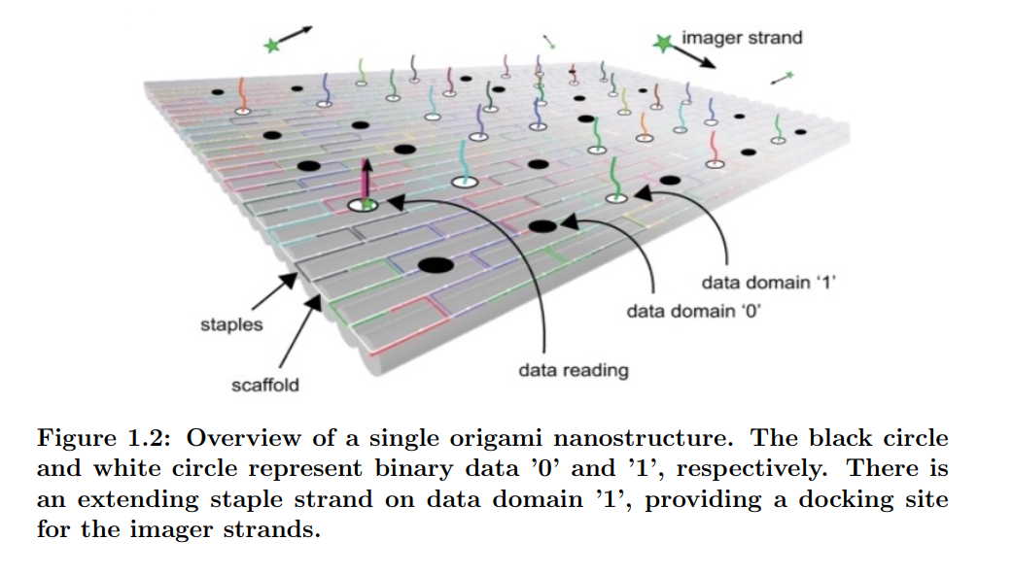
Digital Nucleic Acid Memory (dNAM)
In the dNAM approach, digital information is encoded into specific locations within DNA origami structures.
During the origami formation, the staple strands are arranged at addressable locations that define an indexed matrix of digital information - Encoding
Binary states are defined by the presence (1) or absence (0) of the data domain.
These binary states are read with a super-resolution microscopy technique called DNA Points Accumulation for Imaging in Nanoscale Topography (DNA-PAINT) - Decoding

Slide 6
dNAM - Encoding
The primary goal of the dNAM encoding process is to ensure error free data recovery.
In the encoding algorithm, fountain code is employed to generate the data droplets.
At first, the string message is converted into binary data bits.
The binary string is divided into 10 equal sized non-overlapping segments.
The substrings are then combined using the XOR operation to form droplets.
Data String: “Data is in our DNA!”
Number of bits after converting to binary string: 160
Number of bits of each segment, 160/10 = 16
segments are combined in different combinations to generate 15 droplets using the fountain code.
Each of the droplets are mapped into 6X8 matrices adding the index, orientation bits, checksum bits, and parity bits.
Total number of bits = 15 droplets X 48 bits = 720 bits

Slide 7
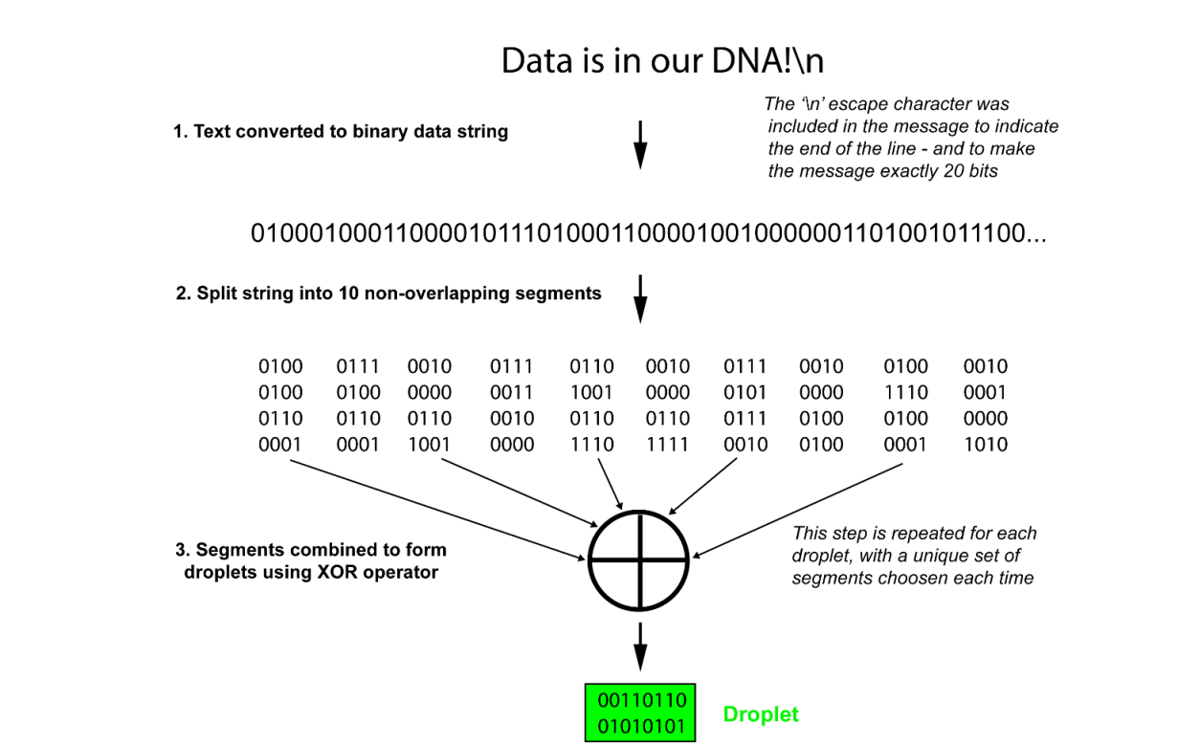
dNAM - Encoding

Slide 8
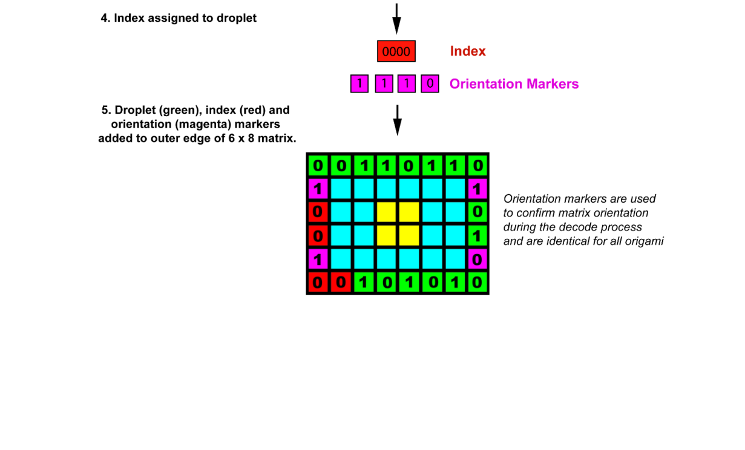
dNAM - Encoding

Slide 9
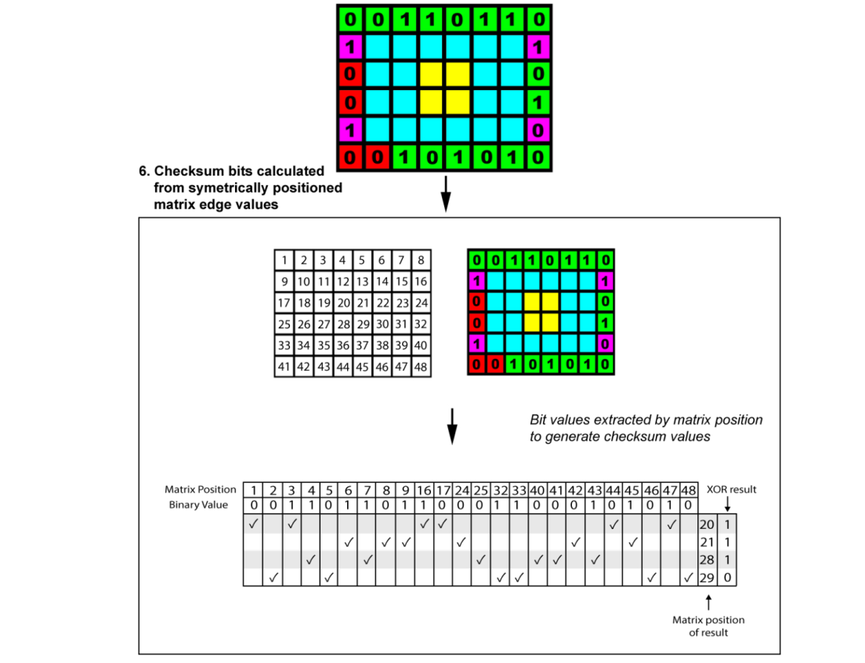
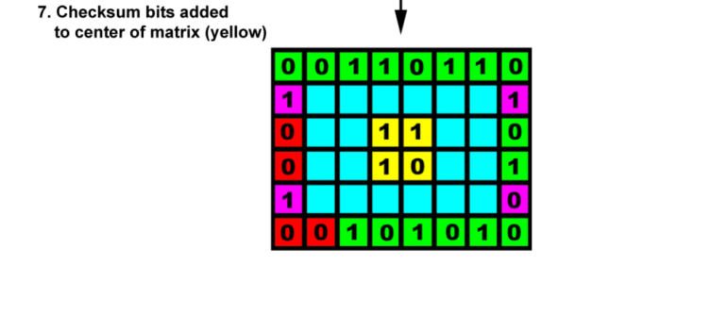
dNAM - Encoding

Slide 10
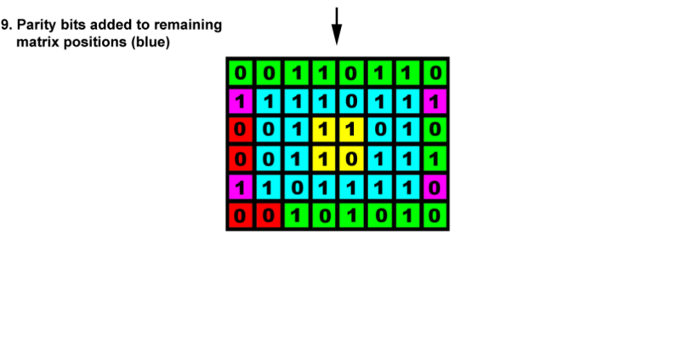
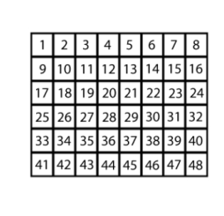
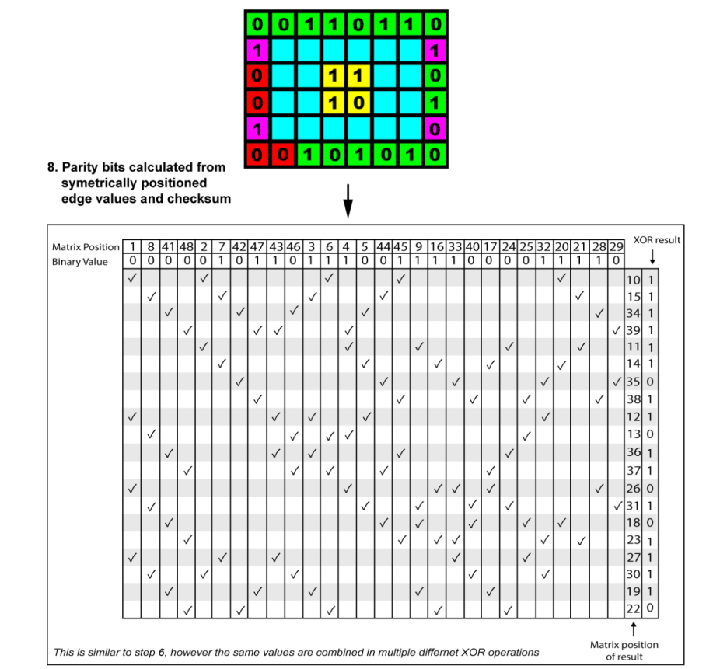
dNAM - Encoding

Slide 11
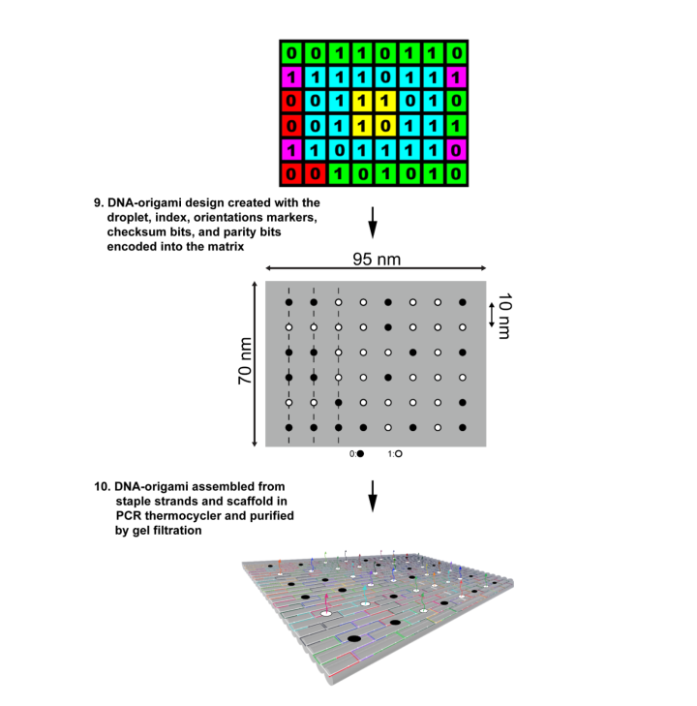
dNAM - Encoding

Slide 12
Encoding Requirements
Rotation Invariant
The mapping relation between each parity and data bit needed to be rotation invariant.
That means, the relationship should be same regardless of the direction or orientation.
This property is retained by mirroring the data points on the center axis in each direction.
The constraint: The matrix rows and columns number must be even for mirroring.
Even parity and Data coverage
Each parity contained a predefined number of data bits and vice-versa.

Slide 13
Limitations
The mapping scheme is designed for only 6X8 matrix, 48 bits data which is not realistic.
The mapping is hand picked (hardcoded) and static in nature. It may only handle the string “”Data is in our DNA!\n” properly. (anticipated)
What does happen if the data string has been altered?
The fountain code can result in data overhead. We may need to another approach to replace this.
We found a relatively new error correction scheme “Turbo Code” which is powerful while passing data over noisy channel.
Can it be implemented in our new approach?
We need further investigation though.

Slide 14
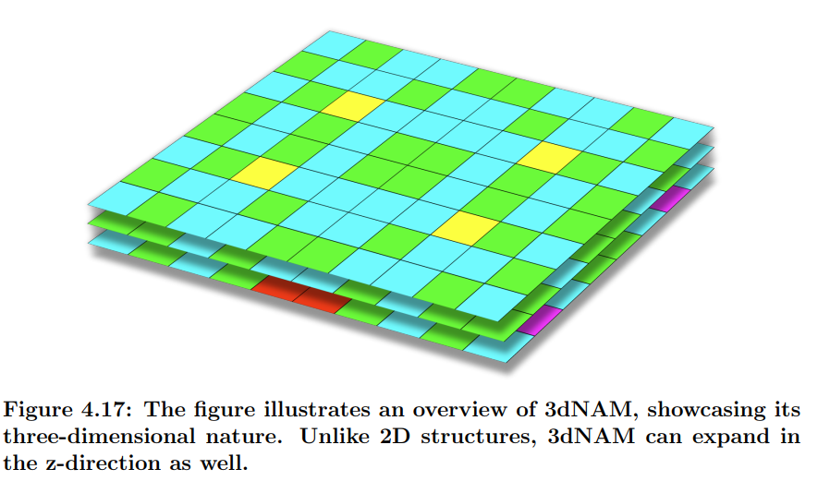
3d NAM - SemiSymbio3
Built upon the framework of dNAM, introduces a novel approach for data storage.
Utilizing three-dimensional instead of two-dimensional structures.
Provide more surface for data bits.
Hence, relatively big data matrix can be stored.

Slide 15
3d NAM Encoding
In the previous encoding algorithm, the data and indexing bits have been stored around the edge.
The anticipation was that the edges would be more error-prone.
But the experiment in the wet lab did not reveal that behavior.
Thus, in the 3DNAM all the parity bits, data bits, and the checksum bits can be distributed randomly throughout the origami.

Slide 16
3d NAM Encoding
Data matrix: 8X10
Layer: 3
Total_bits: 8X10X3 = 240
First and third layers are for data, index bits, and orientation bits for fast accessing.
When you start decoding, obviously you need to know which origami is this and direction you need to read.
Second layer is for parity and checksum bits.
Data + index + orientation = 160
Parity + checksums = 80

Slide 17
3d NAM Encoding
Data matrix: 8X10
Layer: 3
Total_bits: 8X10X3 = 240
First and third layers are for data, index bits, and orientation bits for fast accessing.
When you start decoding, obviously you need to know which origami is this and direction you need to read.
parity and checksum bits are evenly distribution all over the layers.
Data + index + orientation = 160
Parity + checksums = 80

Slide 18
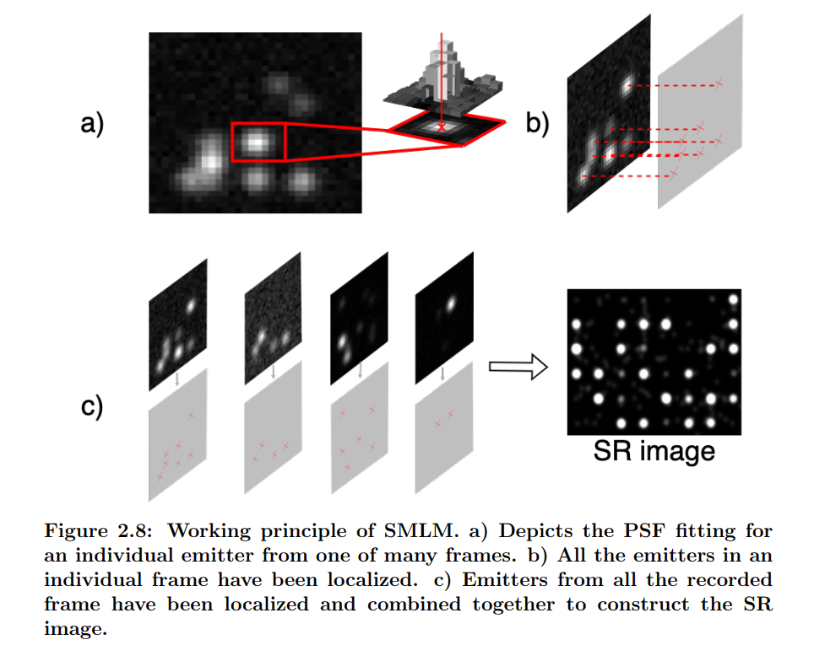
Emitter Localization
In SMLM, individual molecules are isolated and imaged over extended periods.
In each image, a small fraction of emitters stochastically enters a bright state.
How does the Thunderstorm and picasso work for filming?

Slide 19
Deep Learning Based Emitter Localization
DL can detect the underlying patterns more efficiently than any other ML algorithms as it utilizes multiple layers.
Image Up-Scaling: Instead of directly predicting the emitter position, enhancing the image resolution can be more efficient preserving the Point Spread Functions (PSF).
In the previous NAM approach, two separated U-net based DL have been deployed to increase the resolution.

Slide 20
Dataset
For Deep Learning, dataset is required to train the model.
For 3dNAM, how would we get the dataset?
Simulation
To test the system, random images need to be generated through simulation.
We need to also work on this simulation techniques.

Slide 21
Thank You!
Q & A

Slide 22
References
George D. Dickinson, Golam Md Mortuza, William Clay, Luca Piantanida, Christopher M. Green, Chad Watson, Eric J. Hayden, Tim Andersen, Wan Kuang, Elton Graugnard, Reza Zadegan, and William L. Hughes. An alternative approach to nucleic acid memory. Nature Communications, 12(1), April 2021. doi: 10.1038/s41467-021-22277-y. URL https://doi.org/10.1038/ s41467-021-22277-y.
Elias Nehme, Lucien E. Weiss, Tomer Michaeli, and Yoav Shechtman. DeepSTORM: super-resolution single-molecule microscopy by deep learning. 5(4): 458, 2018. ISSN 2334-2536. doi: 10.1364/OPTICA.5.000458. URL https: //www.osapublishing.org/abstract.cfm?URI=optica-5-4-458.
Paul W. K. Rothemund. Folding DNA to create nanoscale shapes and patterns. Nature, 440(7082):297–302, March 2006. doi: 10.1038/nature04586. URL https://doi.org/10.1038/nature04586.
Victor Zhirnov, Reza M. Zadegan, Gurtej S. Sandhu, George M. Church, and William L. Hughes. Nucleic acid memory. 15(4):366–370. ISSN 1476-1122,
1476-4660. doi: 10.1038/nmat4594. URL http://www.nature.com/articles/nmat4594.
Martin Ovesn´y, Pavel Kˇr´ıˇzek, Josef Borkovec, Zdenˇek Svindrych, and ˇ Guy M. Hagen. ThunderSTORM: a comprehensive ImageJ plugin for PALM and STORM data analysis and super-resolution imaging. 30(16):2389–2390. ISSN 1367-4803, 1460-2059. doi: 10.1093/ bioinformatics/btu202. URL https://academic.oup.com/bioinformatics/ article-lookup/doi/10.1093/bioinformatics/btu202.
Ralf Jungmann, Christian Steinhauer, Max Scheible, Anton Kuzyk, Philip Tinnefeld, and Friedrich C. Simmel. Single-molecule kinetics and super-resolution microscopy by fluorescence imaging of transient binding on DNA origami. 10 (11):4756–4761. ISSN 1530-6984, 1530-6992. doi: 10.1021/nl103427w. URL https://pubs.acs.org/doi/10.1021/nl103427w.

